Slide 1
NIEM 200
NIEM Project Management
Presenter Name
Organization
Date
TRAINING

Slide 2
NIEM Project Management
This course will provide you an overview of the National Information Exchange Model (NIEM) Exchange Development Lifecycle—in the context of managing the development of a NIEM-based exchange.
TARGET AUDIENCE: Project Managers, Program Managers, Architects
DURATION
2 Hours
PREREQUISITES
NIEM 100: NIEM General Overview
NIEM 101: Technical Introduction to NIEM
Prior project management experience may facilitate a greater understanding of the materials presented in this course.

Slide 3
Learning Objectives
This course will help you understand the Exchange Development Lifecycle so that you can successfully coordinate information sharing projects using NIEM.
By the end of this course, you will be able to:
Summarize each phase of the NIEM Information Exchange (IEPD) Development Lifecycle
Apply NIEM Information Exchange (IEPD) Development Lifecycle phases to your effort
Identify common exchange risks

Slide 4
Agenda
NIEM in Review
NIEM Information Exchange (IEPD) Development Lifecycle
Conclusion

Slide 5
NIEM in Review
Course Progress
30% complete

Slide 6
NIEM Overview
NIEM is a community-driven, government-wide, standards-based approach to exchanging information. Diverse communities can collectively leverage NIEM to increase efficiencies and improve decision-making.
It is available to everyone, including both public and private organizations. NIEM includes a data model, governance, training, tools, technical support services, and an active community to assist users in adopting a standards-based approach to exchanging data.
Community
Technical Framework
Support Framework
Formal Governance Processes
Data Model
Tools for Development and Discovery
Online Repositories
XML Design Rules
Established Training Program
Mission-Oriented Domains
Development Methodology
Implementation Support
Self-Managing Domain Stewards
Predefined Deliverables (IEPD)
Help Desk & Knowledge Center

Slide 7
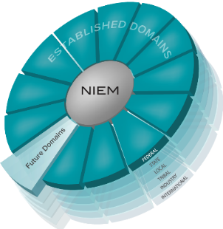
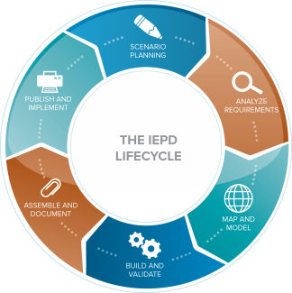
How NIEM Works
Common Language (Community-driven Data Model)
Repeatable, Reusable Process
(Information Exchange Development Lifecycle)
Built and governed by the business users at Federal, State, Local, Tribal, International and Private Sectors

Slide 8
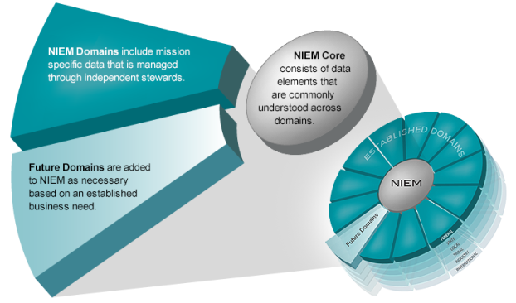
Model Overview
Words are to a dictionary as elements are to a data model.
Think of the NIEM data model as a mature and stable data dictionary of agreed-upon terms, definitions, and formats independent of how information is stored in individual agency systems.
The data model consists of two sets of closely related vocabularies: NIEM Core and individual NIEM Domains.

Slide 9
NIEM provides…
Collaboration
Consistency
Development
Support
Brings stakeholders together through reuse and community engagement
Provides a standardized framework and mature governance
Supplies tools to aid in discovery and creation of exchanges
Provides technical assistance and training
Which Lead To
Lower Development Costs
Enhanced Mission Capabilities
Common Vocabulary
Reduced Maintenance Costs

Slide 10
NIEM Information Exchange (IEPD) Development Lifecycle
Course Progress
60% complete

Slide 11
What is a niem exchange?
An Information Exchange Package Documentation (IEPD) is a collection of artifacts that describe the construction and content of an information exchange
Core Functions of an IEPD:
Developed to provide the business, functional, and technical details of the information exchange through predefined artifacts
Created with a core set of artifacts in a prescribed format and organizational structure to allow for consistency
Designed to be shared and reused in the development of new information exchanges through the publication in IEPD repositories

Slide 12
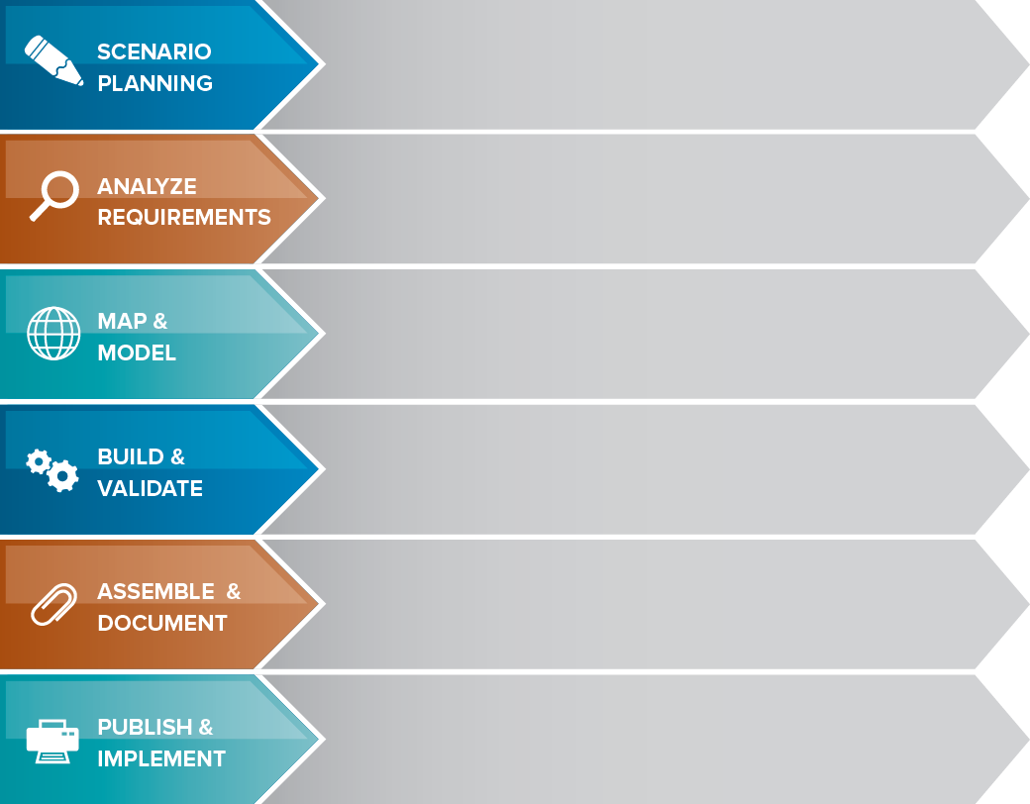
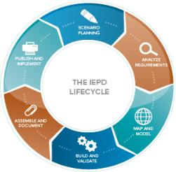
IEPD Lifecycle Recap
Review background, assess resource impact, understand business context, and identify information exchange business scenarios
Selected information exchange scenario is further elaborated to understand and document the business context and data requirements
Create an exchange content model based on information exchange requirements. The Exchange Content Model is then mapped to NIEM.
Create a set of exchange-specific NIEM conformant XML Schemas that implement the data model created for the exchange
Prepare and package all related files for this IEPD into a single self‐contained, self-documented, portable archive file
Implement the IEPD into production as well as publish the IEPD for search, discovery, and reuse.

Slide 13
The IEPD Artifacts
Business Process Diagrams
Use Case Diagrams
Sequence Diagrams
IEPDs contain both required and recommended artifacts
Required:
Bold and Blue
Recommended:
Plain
Note:
Best practices for most organizations include many of the artifacts listed here.
Please review. Model Package Description (MPD) Specification for more information.
Business Rules
Business Requirements
Exchange Content Model
Mapping Document
Subset Schema
Exchange Schema
Wantlist
Constraint Schema
Extension Schema
Reference Schema
XML Stylesheets
Master Document
Catalog
Change Log
Sample XML Instances
No required artifacts. Publish the IEPD to a repository and implement the exchange

Slide 14
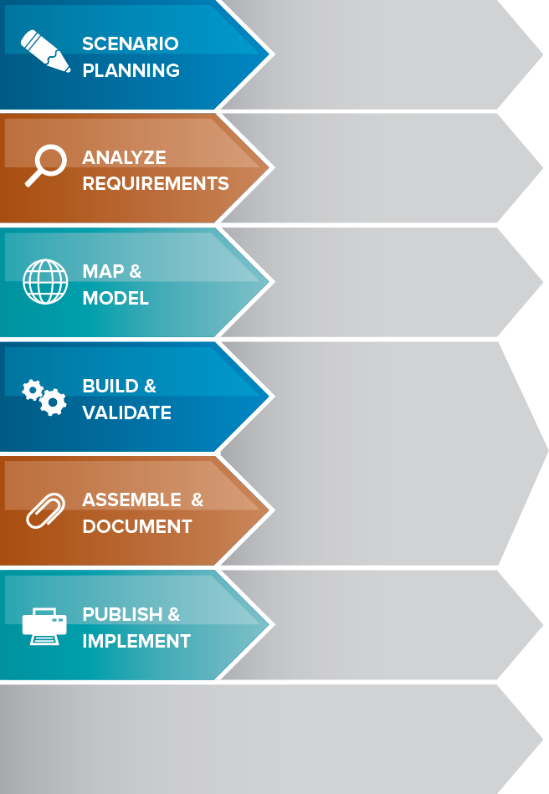
Systems Development Life Cycle
Plan
Develop high level scope and goals of intended system
The Systems Development Life Cycle (SDLC) is a common methodology used for creating information systems.
The IEPD Lifecycle aligns closely with the phases of the SDLC.
Requirements
Analyze goals and break them down into exact requirements
Design
Transform requirements into detailed system capabilities
Develop
Develop system per design specifications
Implement
Test and deploy system
Maintain
Sustain system per future plan and eventually move to disposition

Slide 15

IEPD REUSE
Existing IEPDs, after publication, can be reused partially or fully, which can:
Decrease IEPD development time
Reduce development cost
Increase Return on Investment (ROI)
Increase consistency of data definitions
IEPD REPOSITORIES, such as the IEPD Clearinghouse, can be leveraged to search and reuse existing IEPDs.
NIEM.gov/ojpiepdclearinghouse
ARTIFACTS and ELEMENTS within IEPDs can be leveraged to facilitate development and ease the burden on resources.

Slide 16
Example: IEPD ELEMent reuse
Since NIEM exchange developers follow the same technical framework- the IEPD Lifecycle--they can borrow from and reuse each other’s work.
Because the NIEM data model is composed of data elements that cross sectors, functions, and geographic boundaries, an exchange developed for one organizational business requirement could be “reused,” partially or fully, for a different need within, or by another organization.
Commonweath of Virginia
Developed an Exchange
State of New Jersey
Reused the Exchange
Child Welfare Information Exchange
Element 1
Element 2
Element 3
Element 4
Element 5
Child Welfare Information Exchange
Element 1
Element 3
Element 5
Re-use
x
x
x
x
x
x
Data Specific to Child Welfare in NJ
Element 6
Element 7
Element 8

Slide 17
NIEM Conformance
NIEM defines three types of conformance:
NIEM XML Schemas conform to the NIEM Naming and Design Rules (NDR).
NIEM Information Exchange Package Documentation (IEPD) conforms to the requirements of the NIEM Model Package Description (MPD) Specification.
NIEM XML Instances conform by correctly validating* to NIEM-conforming XML Schemas, with additional conformance rules specified by the NIEM NDR.
Systems and databases CAN NOT conform to NIEM. Only XML schemas, XML Instances, and IEPDs can conform to NIEM.
Each XML Schema must conform to the NIEM Naming and Design Rules for its conformance target.
* Conformance to the NIEM NDR assumes well formed XML

Slide 18
NIEM General Conformance Rules
An IEPD conforms to NIEM under the following conditions:
Each XML Schema within the IEPD adheres to all rules in NIEM NDR for the schema’s conformance target class.
Each XML sample instance within the IEPD adheres to all rules in NIEM NDR for XML Instances.
The IEPD itself adheres to the Model Package Description (MPD) Specification (including required files, packaging, metadata, etc.). This requires that its schemas and sample instances conform to the NIEM NDR.
The IEPD does not unnecessarily duplicate NIEM components; if an existing NIEM component matches the business semantics required by the IEPD, then that component is used by the IEPD, either directly or as the basis for derived components.
The IEPD preserves semantic and structural consistency; each NIEM component is used in a manner consistent with the component’s structural definition and business semantics.
There are subjective factors in applying these rules that require diligent consideration by the organization(s) developing the IEPD.
It is important that decisions about semantics be made (or reviewed) by business subject-matter experts who have thorough knowledge of the business processes and domain for which the exchange is designed.

Slide 19
Phase 1: Scenario Planning
Purpose
Complete the initial tasks associated with defining an information exchange and understanding the business requirements for the exchange
Deliverables
Sequence Diagrams: A graphical representation of the messages sent sequentially within an information exchange
Business Process Diagrams: Textual or graphical representation of the activities involved in an exchange, similar to a workflow
Use Case Diagrams: A graphical representation of the functionality of a particular information exchange as perceived through an external observer

Slide 20
Scenario Planning: Deliverables
Use Case: Prescription Drug Monitoring information Exchange (PMIX)
Business Process Diagram
Sequence Diagram
Prescriber/ Dispenser
Prescription Monitoring Program System
PMIX Hub

Slide 21
Scenario Planning: Tactical Advice
Project Manager Responsibilities
Facilitate working group meetings between exchange partners, developers, and architects
Review IEPD deliverables for scope, detail, and accuracy
If necessary, establish granular work plans for more complicated IEPD deliverables
Key Considerations
Prior documentation can be used to support the development phase
Use cases should be checked by technical and non-technical stakeholders on each side of the exchange
Sequence diagrams should be checked by multiple technical stakeholders on each side of the exchange
Deliverables in the “Scenario Planning” phase will drive the business goals of the exchange and will have a large impact on the technical deliverables

Slide 22
Phase 2: Analyze Requirements
Purpose
Information exchanges are researched and analyzed further to understand and document the business context and data requirements
Deliverables
Business Requirements: A business driver is primarily an operational or functional requirement
Business Rules: For NIEM, business rules are focused on the structure of data (field length, data validation, etc.). When defining an exchange, although not required, it is recommended that all business rules are captured—not just those relating to the data.

Slide 23
Analyze Requirements: Tactical Advice
Project Manager Responsibilities
Establish guidelines for business rules and requirements that align to organizational and NIEM standards
Review requirements upon completion and continuously revisit throughout the entire development process
If necessary, schedule interviews and consensus meetings to gather requirements from stakeholders
Key Considerations
Stakeholders on both sides of the exchange should be involved in as many activities as possible
As with all requirement gathering efforts, this process is iterative and most likely will be visited again
Reaching agreement on IEPD business rules and requirements can be difficult with more sharing partners
Methods such as S.M.A.R.T. are effective for gathering and analyzing requirements (Specific, Measurable, Agreed-upon, Realistic, Time-bound)

Slide 24
Analyze Requirements: S.M.A.R.T.
NIEM does not prescribe any one method, however, utilizing techniques such as S.M.A.R.T. for developing requirements can increase the effectiveness of requirements and help to meet project goals.
S
Specific: As detailed as possible without sacrificing time
M
Measurable: Precise and understandable measures that quantifiably describe what the project is working towards
A
Agreed Upon: Commitment of stakeholders toward the requirements and their objectives
R
Realistic: Must be possible and reasonable to achieve with the allotted project time, cost and people
T
Time-bound: Each requirement should have an associated completion date

Slide 25
Effective Requirement Examples
What do effective business requirements look like?
The client shall provide a valid account number for each message or the capability to correlate existing messages with valid account numbers. Each sent message must have a response within one business day.
The organization shall use these preapproved data elements for account driver transactions for standardization and interoperability purposes. Transition should be complete within 6 months.
Ability to query multiple law enforcement systems for information on apprehended subjects. Complete queries within one week.

Slide 26
Exercise 200-1: Create Effective Requirements
Following an effective method for creating requirements can lead to more precise business requirements
Using the business case on the next slide, think about and create three effective business requirements then share with other project managers to validate.
Objective
Exercise
Create business requirements for an example exchange
Business requirements will be created by participants and then evaluated

Slide 27
Exercise 200-1: Create Effective Requirements
Business Case
A large urban city identified the need to create a series of exchanges that would allow parents, city-wide, to apply online for their children’s school meals program and automate the processing of the request between the Human Services Agency and the school.
This will be implemented via a web-based service that, upon submission, will automatically check the city’s Human Services agency database to ensure the applicant is from a low income family and qualifies for the school meals program. If qualified, the web-based service will then notify the respective school to add the child to the meal program.
Currently, the only means the city has to process school meal program applications is through paper-based applications at the city Human Services Agency office. Once approved, the Human Services Agency faxes approved applications to the particular school where the child attends. Overall, it is a manual process that inhibits timely delivery of citizen services.

Slide 28
Solution: Create Effective Requirements
Results will vary between individuals. Examples of good requirements include:
Candidate Message Exchange Packages
Request from Parent to Human Services Agency for meal program
Eligibility request from Human Services Agency web-based service to eligibility system
Eligibility reply from Human Services Agency to parent
Notification to add child to meal program from Human Services Agency to school
Request from school to Human Services Agency for monthly report
Monthly report reply from Human Services Agency to school
Performance Requirements
The web-based service will notify parents via email whether or not their child qualifies for the school meals program ten minutes after receiving their application.
A school will receive notification within 24 hours of a new qualified child within their school.
Reporting Requirements
Each school in the city shall be able to receive a monthly report of every child in their school who is currently enrolled in the school meals program.
Data Quality Requirements should be taken into consideration once above requirements are discussed.

Slide 29
Phase 3: Map & Model
Purpose
Create an exchange content model; associate local data objects with types and elements in NIEM
Deliverables
Exchange Content Model: Graphical representation of the data and relationships involved in the information exchange
Exchange content models consist of objects, their related elements, and the associations between those objects
Mapping Document: A standardized spreadsheet used to document how exchange data maps to equivalent NIEM data objects
Objects: Construct that represents a person, place, thing, etc.
Elements: Specification that defines a property of an object
Associations: Interactions between objects that portray structure

Slide 30
Map & Model: Deliverables
Exchange
Content Model
Property | IsType | Description | Path
PrescriptionNumber | nc:TextType | The unique identifier of a prescription | **\Prescription\PrescriptionNumber
PrescriptionStartDate | nc:DateType | Date the prescriber ordered the use of the medication to start | **\Prescription\PrescriptionStartDate
PrescriptionEndDate | nc:DateType | Date the prescriber ordered the use of the medication to stop | **\Prescription\PrescriptionEndDate
DrugRefillIndicator | niem-xsd:boolean | Was the prescription a refill (Yes/No) | **\Prescription\DrugRefillIndicator
RefillExperationDate | nc:DateType | How the prescription was communicated to the Dispenser | **\Prescription\RefillExperationDate
TransmissionTypeText | nc:TextType | How the prescription was communicated to the Dispenser | **\Prescription\TransmissionTypeText
TotalRefillsQuantityText | nc:TextType | Number of Refills for a prescription ordered by the Prescriber | **\Prescription\TotalRefillsQuantityText
RXOriginCode | nc:TextType | Code that identifies how the pharmacy received the prescription | **\Prescription\RXOriginCode
RXOriginText | nc:TextType | Code that identifies how the pharmacy received the prescription | **\Prescription\RXOriginText
Mapping Document

Slide 31
Map & Model: Tactical Advice
Project Manager Responsibilities
Establish expectations for exchange content model development, including how business requirements and rules are reflected in the model
Communicate with architects to discover how closely business needs map to the NIEM data model
Coordinate review of the exchange content model and mapping document with multiple technical stakeholders
Key Considerations
Reusing NIEM elements increases consistency and promotes reuse
Each data object should be mapped to an element or type in NIEM, if possible; do not force mapping if it does not make sense
Implementers should create “extensions” to the NIEM data model for elements that do not directly map to NIEM data objects

Slide 32
Phase 4: Build & Validate
Purpose
Create a set of exchange-specific NIEM conformant XML Schemas based upon the mapping values; these schemas will implement the data model created for the exchange
Deliverables
XML Schemas: A type of XML document used to structure and constrain the data of an information exchange (e.g. exchange, subset, extension, and constraint schemas)
Other XML Documents: Additional XML artifacts are included within an IEPD (Wantlist, XML Instance, and XML Stylesheet)

Slide 33
Build & Validate: Deliverables Explained
XML Schemas
Purpose of each schema:
Exchange Schema: Used as an entry point for validation of an XML Instance and contains the root structure of a message
Extension Schema: Defines the data types and elements used by an exchange that extend but are not contained within NIEM
Subset Schema: Set of schemas that contain a specified subset of NIEM elements and types needed for an exchange
Reference Schema: A schema that is intended to be the authoritative definition schema for a NIEM namespace. This includes the reference schemas for the NIEM Core schema and NIEM domain schemas​.
Constraint Schema: Used to apply constraints or restrictions to data elements within an exchange
Other XML Documents
Purpose of each additional XML document:
Wantlist: Used to specify the elements and types from NIEM that will be used in the subset schemas for an exchange
XML Instance: Used within IEPDs to display an example of an XML message that will be used within the exchange
XML Stylesheet: Used to display XML Instances in human-readable form within a browser

Slide 34
Build & Validate: Tactical Advice
Project Manager Responsibilities
Communicate with implementers about risks to the project plan associated with schema development
Communicate project progress and risk frequently
Establish a review of NIEM XML documents
Key Considerations
Schema development inherently poses a schedule risk associated with the possibility of unforeseen problems in development
Risks are often known by technical team members and constant communication with these team members will help expose these risks
Consistent communication during schema development (with stakeholders) is important
Short timeframe between milestones in the project plan prevents procrastination and project slips

Slide 35
Phase 5: Assemble & Document
Purpose
Complete IEPD documentation and package all required artifacts for this IEPD into a single self‐contained, self-documented, portable archive file
Deliverables
Master Document: Contains the documentation necessary to effectively describe the information exchange
Catalog XML: artifact validates with the NIEM Model Package Description (MPD) catalog schema (XSD) and resides in the root directory of the MPD bearing the file name “mpd-catalog.xml”
Change Log: IEPD change log file is included in the root directory of the IEPD, beings with the substring “changelog” and records changes to previous IEPD schemas that is represented
Sample XML Instances: XML Schemas define XML data exchange instances. Instances provide insights into what the exchange representation would look like during implementation

Slide 36
Assemble & Document: Tactical Advice
Project Manager Responsibilities
Assign technical and non-technical resources to IEPD Master Document and package creation
Manage internal review and if possible, external review of the IEPD
Review the IEPD Master Document for accuracy
Final review of entire IEPD Package
Key Considerations
IEPD Master Document should accurately reflect the business needs of the exchange
Review the IEPD package as well as the individual artifacts for conformance to NIEM
Multiple technical reviewers, or one very experienced reviewer, of an IEPD will help to identify issues of non-conformance within an IEPD

Slide 37
IEPD Peer Review Process Example
As a best practice, organizations use an IEPD Peer Review Process to establish a consistent process for reviewing IEPDs
Submit
Preliminary Review
Detailed Review
Accept & Publish
IEPD is provided to the reviewing group for review
IEPD developer briefs the reviewing group on the IEPD
IEPD is assessed by member(s) of the reviewing group
Developer provides assistance to the review process, if necessary
IEPD is reviewed against business requirements and NIEM specifications
The IEPD is accepted by the reviewing group
For reuse: IEPD should be published to an online repository to avoid duplication

Slide 38
Phase 6: Publish & Implement
Purpose
Publish the completed IEPD to a repository and then implement the information exchange in the production environment
Additional Insight
There are many different options for publishing and implementing an IEPD and these decisions will largely be decided upon by available resources and organizational constraints
Publish: To promote reuse, IEPDs can be published to a repository internal or external to an organization
Implement: In order to maintain interoperability, NIEM does not provide implementation specifications

Slide 39
Publish & Implement: Tactical Advice
Project Manager Responsibilities
Manage the IEPD Review Process and requested IEPD changes
Decide on IEPD publication location(s)
Manage the implementation of the exchange
Key Considerations
The IEPD review process might be iterative and could concurrently be completed with implementation
Multiple IEPD publication repositories exist; project managers should decide on publication locations that maximize IEPD reuse
Implementation of an information exchange is outside the scope of NIEM

Slide 40
Common Exchange Risks
RISK | PROBLEM | MITIGATION
Dependency of Deliverables | IEPD deliverables are very closely correlated and a mistake in one can cause significant rework in others | Project managers need to make certain that early deliverables are thoroughly reviewed during the development process
Barriers to Collaboration | Reaching agreement with exchange partners regarding requirements and other items can delay the start of development | Establishing working groups, holding consensus meetings, and other methods have worked for many organizations in the past
Implementing an IEPD | Lack of business documentation hampers maintenance of the IEPD and limits reuse | Ensure both business and technology requirements gathered appropriately throughout IEPD Lifecycle

Slide 41
Maintain an Exchange
After the project is complete, the IEPD needs to be maintained throughout its existence.
To sustain an IEPD:
 | Ensure that any changes to an information exchange are correctly reflected within the IEPD.
 | A governance process, if applicable, should be established to actively manage the changes identified for an IEPD
 | Over time, the technical architecture of the information exchange is likely to change; update the IEPD to reflect these changes
 | Once changes are made to the IEPD, publish a new version of the IEPD within online repositories
Choosing to not maintain an IEPD inhibits re-use within and outside the organization.
!

Slide 42
Conclusion
Course Progress
90% complete

Slide 43
Learning Recap
This course should now enable you to successfully coordinate information sharing projects using the NIEM Information Exchange (IEPD) Development Lifecycle.
You should now be able to:
Summarize each phase of the NIEM Information Exchange (IEPD) Development Lifecycle
Apply NIEM Information Exchange (IEPD) Development Lifecycle phases to your effort
Identify common exchange risks

Slide 44
Additional NIEM Resources
Documentation
and Standards
For technical documentation:
NIEM.gov/reference
For all things NIEM:
NIEM.gov
DOCUMENTATION AND STANDARDS
Training
and Technical Assistance
For available resources that provide support and assistance:
NIEM Training: NIEM.gov/training NIEM Webinars: NIEM.gov/webinars NIEM Helpdesk: NIEM.gov/contactus
TRAINING & TECHNICAL ASSISTANCE
Available tools for developers: Visit the NIEM Tools Catalog today!
NIEM.gov/tools
For info on NIEM Engagement Process:
NIEM.gov/roadmaptoadoption
Tools
TOOLS

Slide 45
Next Steps…
Start your action plan and schedule your resources for NIEM training!
 | NIEM 100 | NIEM 101 | NIEM 200 | NIEM 300 | NIEM 301 | NIEM 302 | NIEM 303
Executive Managers
Program and Project Managers
Architects
Developers
= Required
= Optional depending on role

Slide 46
End of course
Course Progress
100% complete

